Slide 1

2-D Adventure – Episode 02
Notes:
Today we’ll be adding more elements to the beginning of our game.

Slide 2
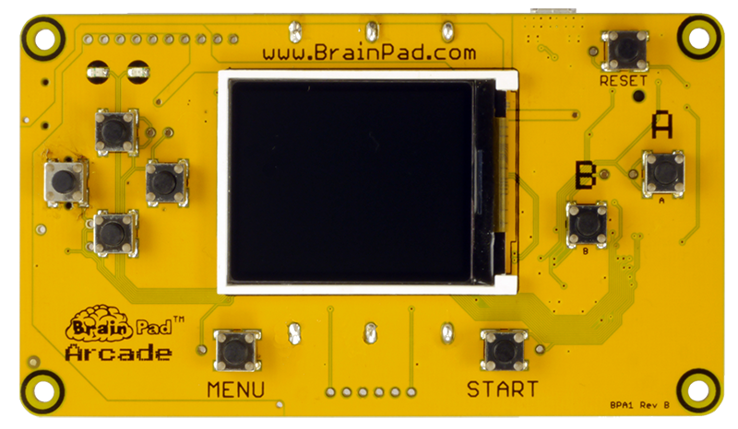
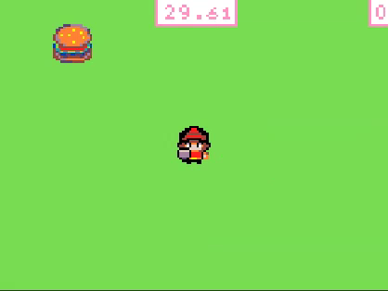
Let’s create a 2-D Adventure game.
Notes:
Now that we’ve created our ‘Hero’ Sprite and they have something to chase. Let’s turn what we have into a playable game. After our ‘Hero’ gets the food we need to create another food item to chase.

Slide 3
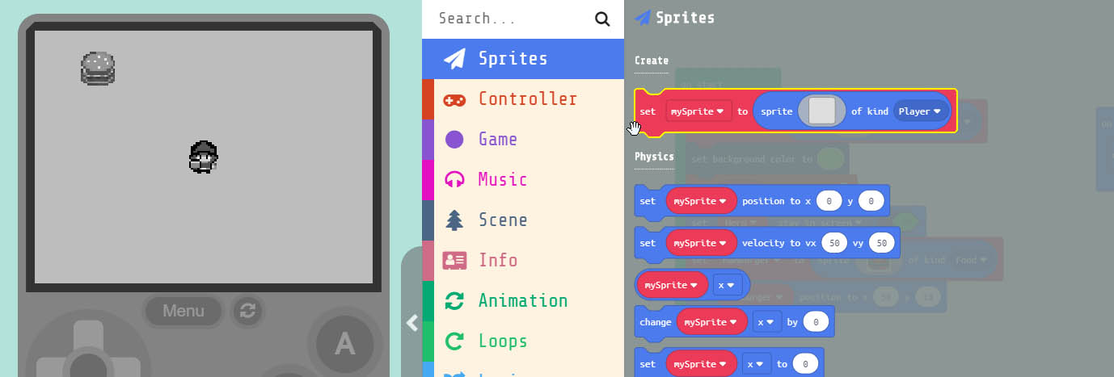
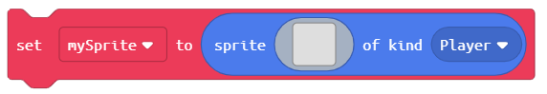
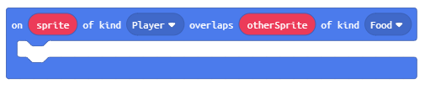
Grab the block
and drag it into the block
Notes:
Just like we created our Hamburger Sprite the first time we must create another one when the other is destroyed. Under the Sprite menu, grab the ‘set mySprite to’ block. We need to drag this into the Event block that detects when our ‘Hero’ overlaps a Sprite that is ‘Food’. Drag it into the bottom.

Slide 4
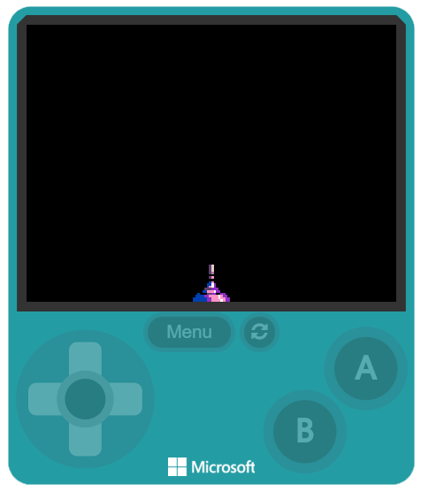
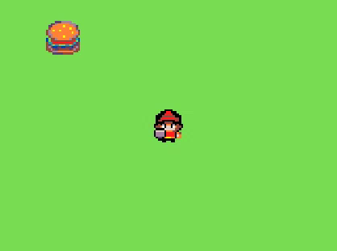
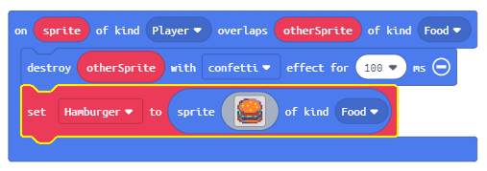
Change the name to ‘Hamburger’
and the kind to ‘Food’ This is just like the one in the
‘on start’ block. Now when we get the ‘Hamburger’
a new one will appear.
Notes:
Change the name of the Sprite variable to ‘Hamburger’ and the kind to ‘Food’. This is just like the one inside the ‘on start’ block when we first created the ‘Hamburger’ Sprite. Now when the ‘Hero’ grabs the ‘Hamburger’ a new one will appear. But something isn’t quite right yet. Remember by default any Sprite we add goes right in the middle of screen when we create it. So after we grab our first ‘Hamburger’ they start to all appear in the middle of the screen. So it looks like nothing happens. Let’s set the position of the ‘Hamburger’ somewhere else on the screen first, then we’ll put it in a random location.

Slide 5
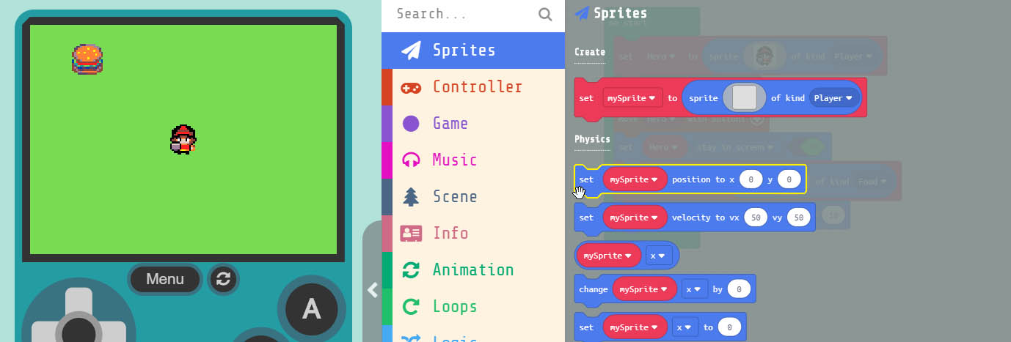
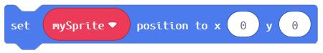
Grab the block
and drag it into the block
Notes:
Grab the ‘set mySprite to’ block and drag into the overlap block that destroys and then creates another Hamburger. Once we’ve added this block we’ll change the parameters of both ‘x’ and ‘y’

Slide 6
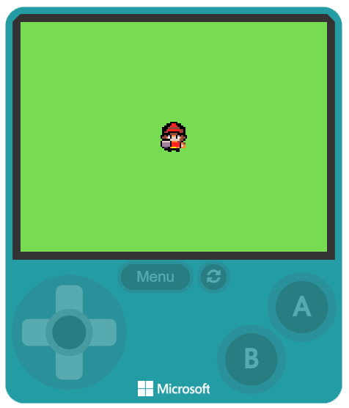
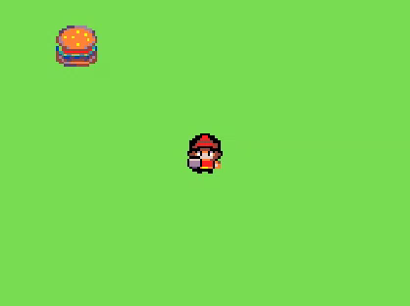
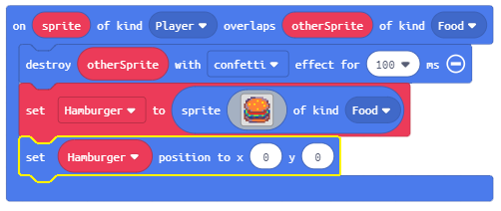
After we add the new block,
change the variable name to
‘Hamburger’.
But it’s still not quite right. We
need to generate a random position
Notes:
After we add the new block, change the variable name to ‘Hamburger’. But it’s still not quite right. The ‘Hamburger’ now appears at the x=0 and y=0 position. We need to generate a random position.

Slide 7

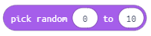
Computer Term:
RANDOM NUMBERS
Computers need something to help them generate truly random
numbers. A ‘seed’ value is used to help, otherwise a computer
just generates numbers that appear random. MakeCode takes
care of all behind the scenes, so we don’t have to worry.
EXAMPLE:
Notes:
RANDOM NUMBERS. Computers need something to help them generate truly random numbers. A ‘seed’ value is used to help, otherwise a computer just generates numbers that appear random. MakeCode takes
care of all this behind the scenes, so we don’t have to worry about seed values for our random numbers.

Slide 8
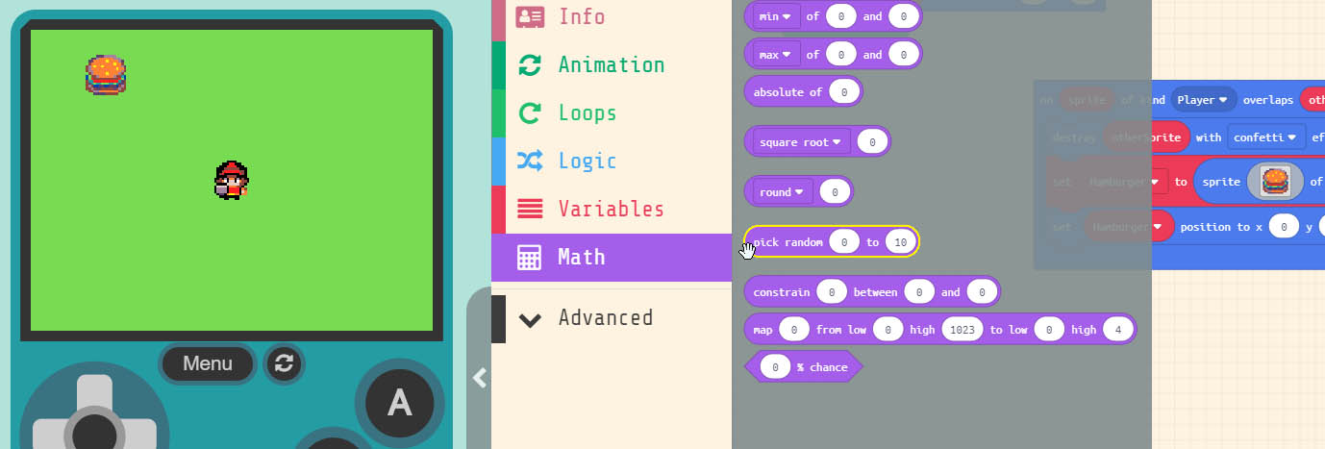
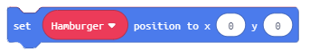
Grab 2 of the blocks
drag both into the block
Inside the ‘x’ and ‘y’ parameter.
Notes:
Under ‘Math’ in the menu grab the ‘pick random 0 to 10’ block. We need two of these one inside each parameter of the ‘set Hamburger position’ block.

Slide 9
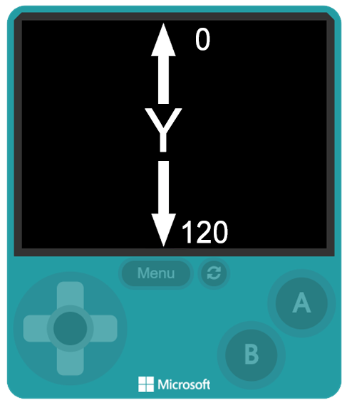
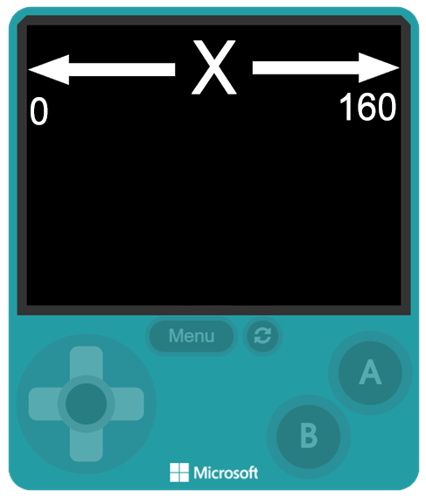
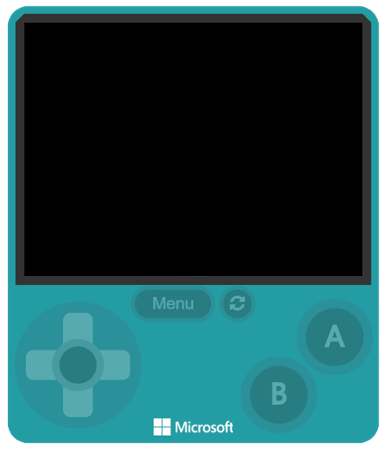
The x & y
parameters
represents
pixels on
the screen
Notes:
The current random numbers generated are between 0 – 10. We need to generate a random number that includes the entire screen. Remember the ‘x ‘& ‘y’ represents a pixel location on the screen. We could manually enter the x from 0 – 160 and y to 0 – 120. But there’s another way to do it too.

Slide 10
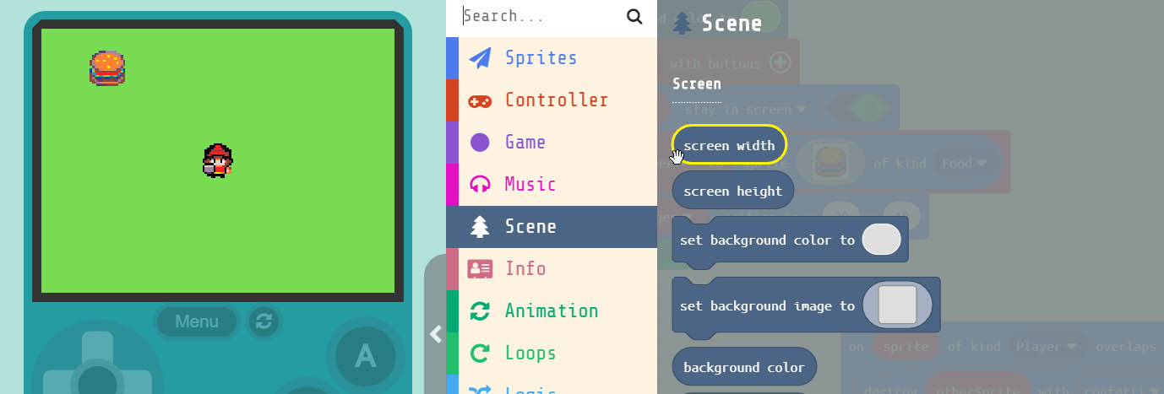
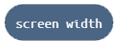
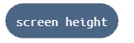
Grab & blocks
drag it into the .
Where the ‘x’ and ‘y’ parameters = 10.
Notes:
Under ‘Scene’ in the menu grab both the ‘screen width’ and ‘screen height’ block. We need to put these inside the last parameters inide the ‘pick random 0 to 10’ blocks. Remember that ‘x’ represents the ‘screen width’ and the ‘y’ represents the ‘screen height’

Slide 11

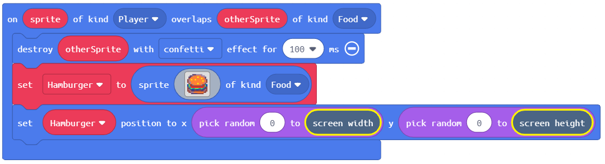
Now when we grab the ‘Hamburger’
the code inside our overlap event,
creates a new ‘Hamburger’ and
places the new one in a random
location on the screen.
Notes:
Now when we grab the ‘Hamburger’ the code inside our overlap event creates a new ‘Hamburger’ and places the new on in a random location on the screen. Let’s add some scoring now. So every time we grab a ‘Hamburger’ we get a point.

Slide 12
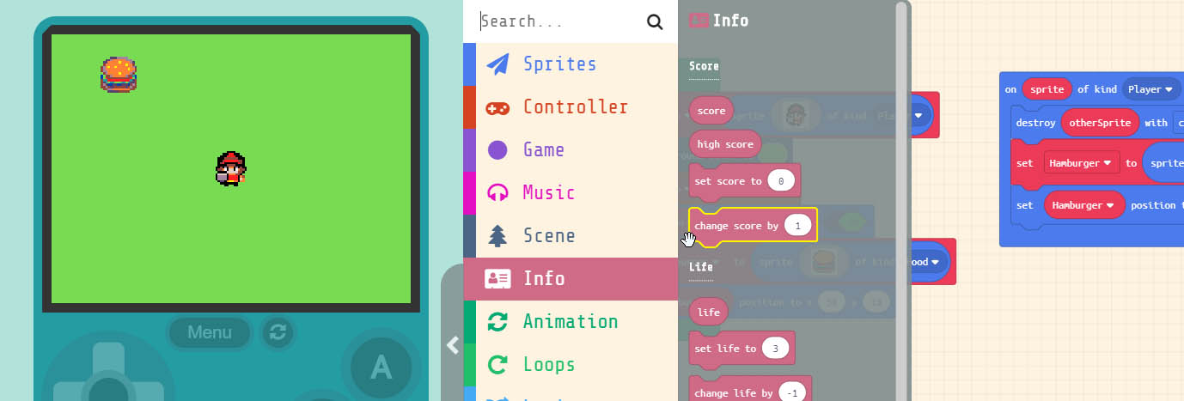
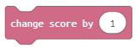
Grab the block
drag it into block.
Notes:
Grab the ‘change score by 1’ block and drag it into our overlap Sprite block already in the workarea.

Slide 13

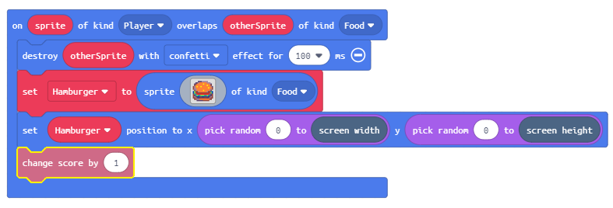
Now every time we grab a
‘Hamburger’ we get a point. Let’s add some challenge, by
adding a timer to the game.
Notes:
Now every time we overlap a ‘Hamburger’ with our ‘Hero’ Sprite we get a point.

Slide 14
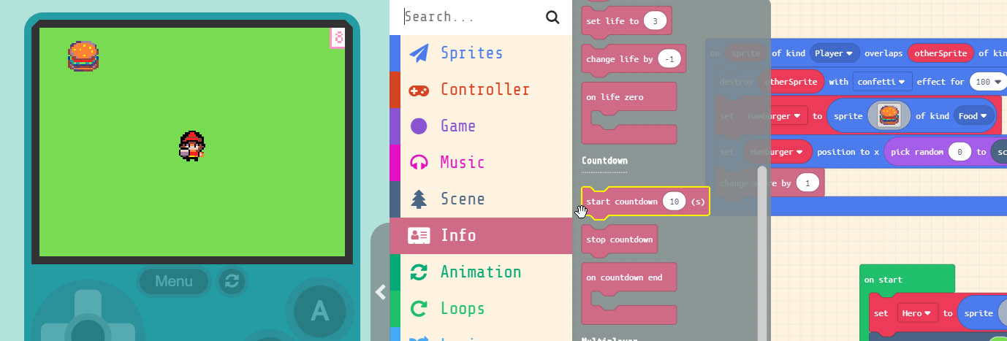
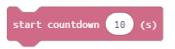
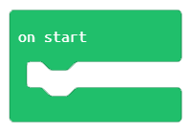
Grab the block
drag it into block.
Notes:
Grab the ‘start countdown 10 sec’ block and drag it into the ‘on start’ block we can put it where we like in the block.

Slide 15
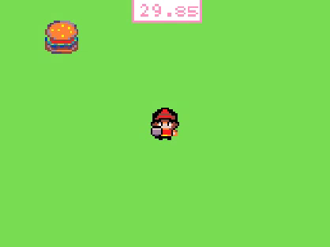
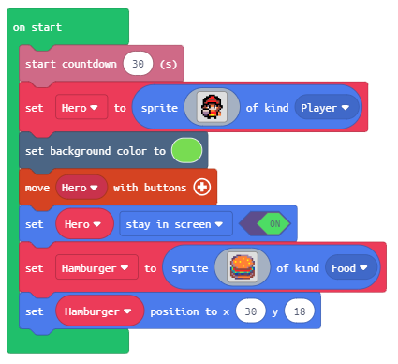
Change the parameter to ‘30’ sec. Now we have a GAME!!!
Notes:
Change the Parameter in the ‘start countdown 10s’ block to 30. This will give us 30 seconds for our ‘Hero’ to grab as many ‘Hamburgers’ as possible.

Slide 16
Hardware Break
Now let’s load what we have on to the BrainPad.
Notes:
Now let’s load what we have so far on the BrainPad.

Slide 17
EXTRA
CREDIT
Notes:
Now that our game is done, students can use the knowledge they’ve gained to change things inside the game to make it their own. Things like making their own Sprite for our ‘Hero’ or changing parameters of the game and see how it affects things.

